Slide 1
SMART CAR PARKING SYSTEM USING IOT
Under guidance of
Mr/Dr. NATARAJ N,
ME
BIT,
Sathy.
202IT210- SAMYUKTHA K R P
202IT242- SURYA S S
202IT124- DANUSHMATHI P
202IT231- SRIVARSHAN M

Slide 2
Abstract
The idea of smart cities has acquired a lot of popularity in latest days. The concept of a smart city today appears to be feasible, due to advancement of the Internet of Things. In order to maximise the performance and dependability of urban infrastructure, consistent attempts are being taken in the domain of IoT. IoT is addressing issues such as road congestion, limited automobile parking spaces, and accident prevention. We describe an IoT-based cloud-integrated smart parking system in this research. The proposed Smart Parking system entails the installation of an IoT module on-site, which is utilised to monitor and communicate the availability of each individual parking place. A android application is also available, which allows people to check the status of the parking spaces and reserve one correspondingly. A increased view of the system architecture is also described in the article. The paper concludes with a discussion of the system's operation in the form of a use case that demonstrates the accuracy of the provided model

Slide 3
Problem Statement Addressed
The lots of folks have difficulty parking their cars. We may also state that it is one of the primary issues that millions of people throughout the world are dealing with.Because of the increase in number of vehicles and their larger sizes, individuals generally spend the most time looking for parking spots. It is unavoidable for people to keep up with the advance in science. Individuals generally are having difficulty parking their vehicles in city parking spaces

Slide 4
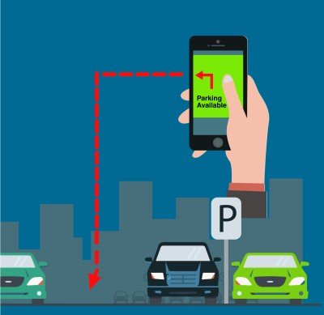
Existing Solution to the Problem Addressed
P&E PARC and PUCRS systems are used by service suppliers to handle a manner that is so wide and diverse. Hardware sensors, dynamic messaging systems, and traffic management devices, wireless and wireline telecommunications systems, computer clients and servers, and hardware drivers and application interfaces are all included in these devices. The largest problem in reducing the cost and difficulty of smart parking is enabling all of these devices from thousands of different vendors to interact and linking them all together one network.

Slide 5
Proposed Solution to the Problem Addressed
Smart parking development entails the creation of an IoT-based system that transmits information about available and occupied parking spaces via a web/mobile application. Each parking space has an IoT gadget, which includes sensors and microcontrollers. The user is given a real-time update on the availability of all parking spaces and is given the option to choose the best one.We launched an internal study effort to investigate the technologies underpinning the smart parking solution. The core concept was to create smart parking utilising the Internet of Things and ultrasonic sensors, with available parking spaces shown in a web app.

Slide 6
Project Work Plan
MEGA ArduinoThe Arduino Mega is a board that contains a microcontroller. There are 54 digital input/output pins, 16 analogue inputs, 4 UARTs (hardware serial ports), a 16 MHz crystal oscillator, a USB connection, and a reset button on this board. It comes with everything you'll need to get started with the microcontroller; simply plug it into a computer with a USB cable or power it with an AC-to-DC adapter or battery.We utilised Arduino UNO in our project, however it didn't have enough pins, whereas Arduino MEGA did. Sensor for ultrasonic wavesUltrasonic sensors are devices that measure distance between the sensor and the target object through an electrical–mechanical energy transition.We utilise it in our project to detect the presence of an automobile in the area and modify the colour of LEDs in certain scenarios.

Slide 7
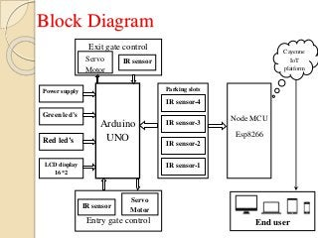
Block Diagram and/or Circuit Diagram

Slide 8
Flow Chart
Start
All the spots are free and LEDs shine green and the #of free spot at LCD = X ( 1,2,3,..,X)
Driver reserve one of the free spots by using WI-Fi and telnet APP.
NO
Did the driver make reservation ?
YES
the LED of this spot will shine blue and the #of free spots = X-1
Driver arrive the parking and check if that is the reserving car by crossing RFID reade
The gate will stay close and the #of free space stay = X
NO
Is this the reserving car ?
YES
The gate will open and its spot will shine red and the # of free space = X-1
NO
the reserving car leave the spot ?
YES
The Led again shine green and the #of free spot increasing by 1
The led stay red until leaving
Finish

Slide 9
Effective utilization of the Modern Tool & Cloud
Ordinary physical goods, unique devices, all types of cars, constructions, inns, and eateries with implanted hardware are all part of the Internet of Things. The product, sensors, and system network all work together to collect, send, and receive data. Distributed storage entails storing data on equipment in a remote physical location that can be accessed via the Internet by any device. Rather than storing documents, customers transmit them to a cloud provider's information server. self-contained hard discs

Slide 10
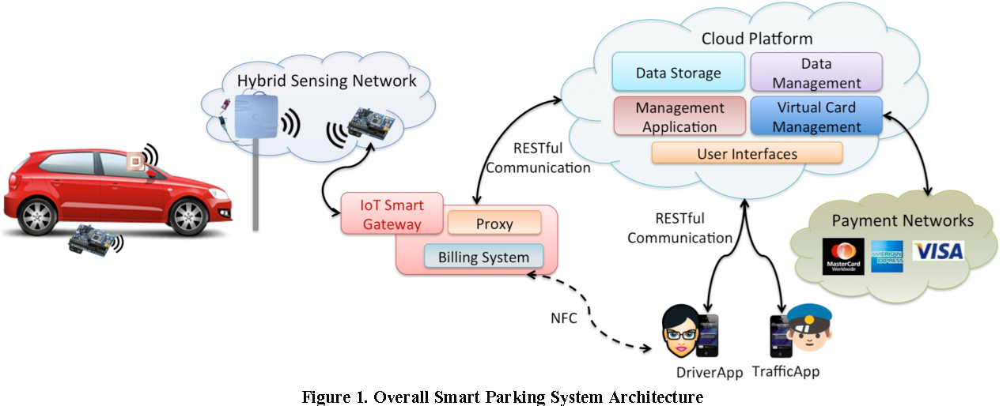
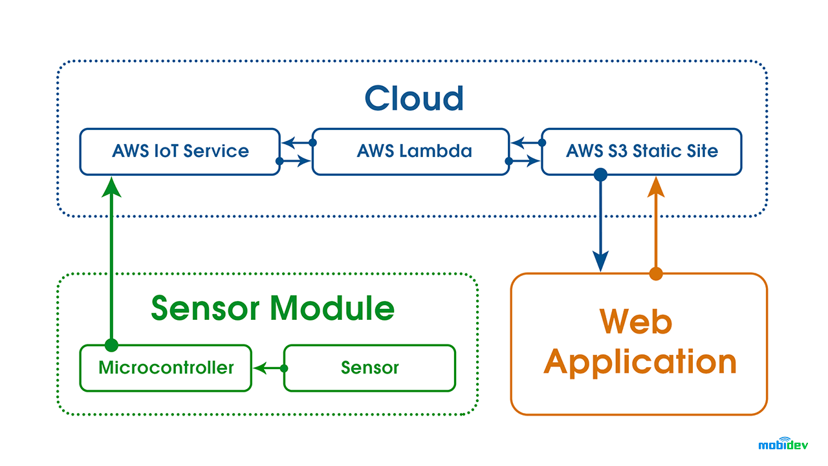
Technology stack & use case

Slide 11
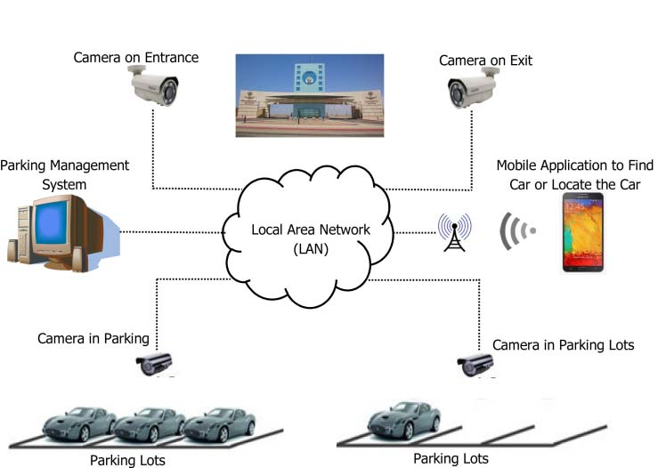
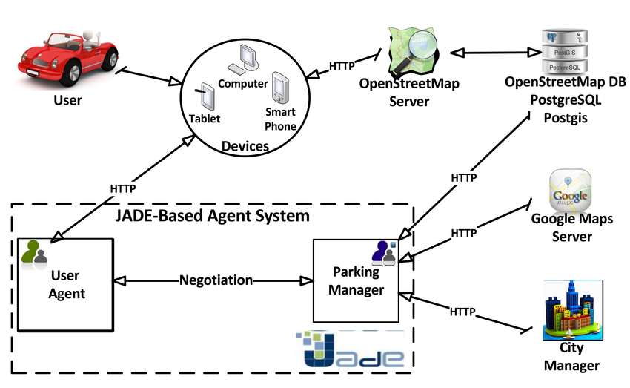
Prototype & Sample Output

Slide 12
Analysis of Results & Discussions
Optimized parking.
Reduced traffic.
Reduced pollution.
Enhanced User Experience.
Integrated Payments and POS.
Increased Safety.
Real-Time Data and Trend Insight.
Decreased Management Costs.

Slide 13
Cost Benefit Analysis (List of Components / Service Used)
(Budget)
S.No | Component Name | Specification (IC number or Range or Value) | Unit Cost | Total Cost
1 | ULTRASONIC SENSORS | 30–500 kHz | RS 129 | RS 400
2 | LED S | 275 to 950 nm. | RS 75 | RS 400
3 | AURDINO MEGA | 7 to 12 volts. | RS 235 | RS 800
4 | AURDINO UNO | 7 to 12 volts. | RS 1000 | RS 2000
5 | XBEE | 100 feet indoors or 300 feet outdoors | RS 400 | RS 800

Slide 14
References
https://mobidev.biz/blog/iot-based-smart-parking-system
https://ieeexplore.ieee.org/document/9122980
https://www.researchgate.net/publication/303842610_IoT_based_Smart_Parking_System

